Slide 1
COMPUTER ORGANIZATION AND ARCHITECTURE
GNA University
Submitted To:- Submitted By:-
Dr. Anurag Sharma Nageshwar Pandey
B.Tech CSE
3rd Sem
GU-2019-3130

Slide 2
MICROPROCESSOR
8085

Slide 3
CONTENT:-
Microprocessor
Addressing Modes
Bus System in 8085
Registers
Interrupts
Instructions and its types
Bus Organization
Features
Reference

Slide 4
MICROPROCESSOR
A microprocessor is a multipurpose, programmable, clock-driven, register-based electronic device that reads binary instructions from a storage device called memory, accepts binary data as input and processes data according to those instructions and provide results as output.
8085 MICROPROCESSOR
A 8085 microprocessor, is a second generation 8-bit microprocessor and is the base for studying and using all the microprocessor available in the market.

Slide 5
ADDRESSING MODES
In 8085 Microprocessor, there are 5 types of addressing modes:-
1.Immediate Addressing Mode
2.Register Addressing Mode
3.Direct Addressing Mode
4.Register Indirect Addressing Mode
5.Implicit Addressing Mode

Slide 6
REGISTERS IN 8085 MICROPROCESSOR
(a) General Purpose Registers
->These are identified as B,C,D,E,H,L. These are combined as register pairs-BC,DE,HL, to perform some 16-bit operation.
(b) Specific Purpose Registers
->Accumulator (part of ALU), Sign flag, Zero flag, Carry flag, Parity flag Flag registers().
(c) Memory Registers
-> There are two 16-bit registers used to hold memory addresses. The size of these registers is 16 bits because the memory addresses are 16 bits.
e.g. Program Counter, Stack pointer

Slide 7
INTERRUPTS IN 8085 MICROPROCESSOR
HARDWARE AND SOFTWARE INTERRUPTS :-
When microprocessors receive interrupt signals through pins (hardware) of microprocessor, they are known as Hardware Interrupts.
Software Interrupts are those which are inserted in between the program which means these are mnemonics of microprocessor.

Slide 8
INSTRUCTIONS IN 8085 MICROPROCESSOR
Arithmetic Instructions
Logical Instructions
Data Transfer Instructions
Branching Instructions

Slide 9
Arithmetic Instructions
Arithmetic Instructions are the instructions which perform basic arithmetic operations such as addition, subtraction and a few more. In 8085 microprocessor, the destination operand is generally the accumulator.
OPCODE | OPERAND | EXPLANATION | EXAMPLE
ADD | R | A = A + R | ADD B
ADD | M | A = A + Mc | ADD 2050
ADI | 8-bit data | A = A + 8-bit data | ADI 50

Slide 10
LOGICAL INSTRUCTIONS
Logical instructions are the instructions which perform basic logical operations such as AND, OR, etc. In 8085 microprocessor, the destination operand is always the accumulator. Here logical operation works on a bitwise level.
OPCODE | OPERAND | DESTINATION | EXAMPLE
ANA | R | A = A AND R | ANA B
ANA | M | A = A AND Mc | ANA 2050

Slide 11
DATA TRANSFER INSTRUCTIONS
Data tranfer instructions are the instructions which transfers data in the microprocessor. They are also called copy instructions.
OPCODE | OPERAND | EXPLANATION | EXAMPLE
MOV | Rd, Rs | Rd = Rs | MOV A, B
MOV | Rd, M | Rd = Mc | MOV A, 2050

Slide 12
BRANCHING INSTRUCTIONS
Branching instructions refer to the act of switching execution to a different instruction sequence as a result of executing a branch instruction.
The three types of branching instructions are:
1.Jump (unconditional and conditional)
2.Call (unconditional and conditional)
3.Return (unconditional and conditional)

Slide 13
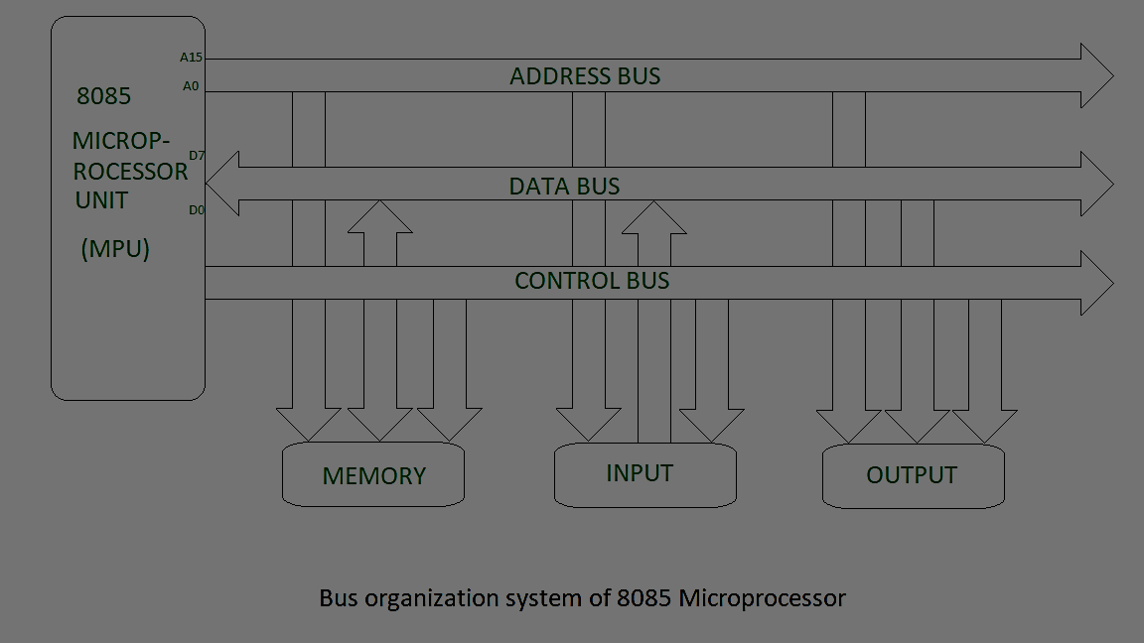
BUS ORGANIZATION OF 8085 MICROPROCESSOR
Bus is a group of conducting wires which carries information, all the peripherals are connected to microprocessor through Bus.

Slide 14
TYPES OF BUSES
There are three types of buses:-
1.Address Bus
2.Data Bus
3.Control Bus-> Some control signals are:
Memory read
Memory write
I/O read
I/O Write
Opcode fetch

Slide 15
FEATURES OF 8085 MICROPROCESSOR
This microprocessor is an 8-bit device that receives, operates, or outputs 8-bit information in a simultaneous approach.
The processor consists of 16-bit and 8-bit address and data lines and so the capacity of the device is 2¹⁶ which is 64KB of memory.
As the 8085 microprocessor has 8-bit input/output address lines, it has the ability to address 2⁸ = 256 input and output ports.

Slide 16
REFERENCES:-
https://www.geeksforgeeks.org/addressing-modes-8085-microprocessor/
https://www.elprocus.com/8085-microprocessor-architecture/

Slide 17
THANK YOU

